Slide 1
United College Of Engineering & Research Naini Prayagraj
PPT on Soft Computing
For CS/IT Vth Semester
Unit 1

Slide 2
Topics
Co(Course Outcomes) of Subject.
What is SC?
What is Neuron
Levels of Brain Organization
Types of Neurons
Biological Neurons
Artificial Neurons
Neural Signal Processing

Slide 3
Co(Course Outcomes) of Subject.
Co1 To devlop the skills to gain a basic understanding of neural network theory . Also explain the architecture of neural network, supervised & unsupervised learning.
Co2 To devlop the skills to gain the knowledge of various neural network models like perception model, single &multilayer model, back propagation model and its applications.
Co3 To understand the concept of fuzzy logic knowledge representation using fuzzy rules and fuzzy to crisp conversion.

Slide 4
Co(Course Outcomes) of Subject.
Co4 To devlop the knowledge of fuzzy membership & fuzzy rules and also their industrial applications.
Co5 To devlop the skills to gain a basic understanding of basic genetic algorithm techniques used in soft computing. Also some mutation generational cycle & its applications.

Slide 5
How do Neurons Communicate?
Electrical Communication. (https://www.youtube.com/watch?v=hGDvvUNU-cw)
Chemical Communication.
Neurons communicate with each other via electrical events called ‘action potentials’ and chemical neurotransmitters.
At the junction between two neurons (synapse), an action potential causes neuron A to release a chemical neurotransmitter.
The neurotransmitter can either help (excite) or hinder (inhibit) neuron B from firing its own action potential.
In an intact brain, the balance of hundreds of excitatory and inhibitory inputs to a neuron determines whether an action potential will result.

Slide 6
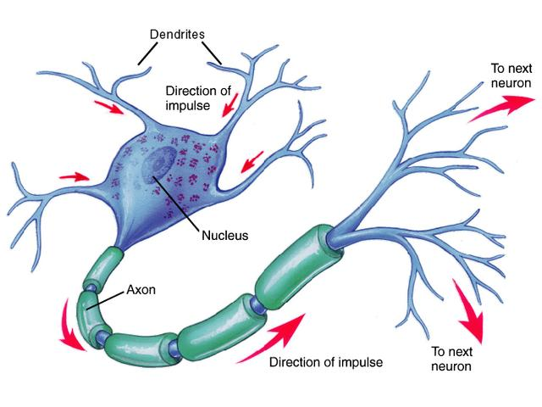

Slide 7
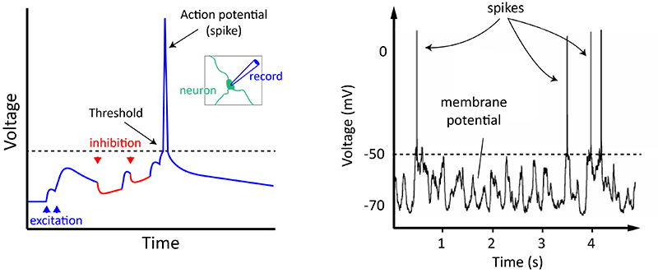
Action potentials are the fundamental units of communication between neurons and occur when the sum total of all of the excitatory and inhibitory inputs makes the neuron’s membrane potential reach around -50 mV (see diagram), a value called the action potential threshold.

Slide 8
The Electrical Part
Action potential is an electrical current sent down the axon.
An action potential occurs when a neuron sends information down an axon, away from the cell body.
The activity within the neurons is electrical. This current causes the neuron to “fire”
This is an “all-or-none” process

Slide 9

Action potentials travel down the axon like a wave of energy

Slide 10
Synaptic transmission
The Synapse is the space between neurons.
Information must be transmitted across the synapse to other neurons via the neurotransmitters.
This is an electrochemical process

Slide 11
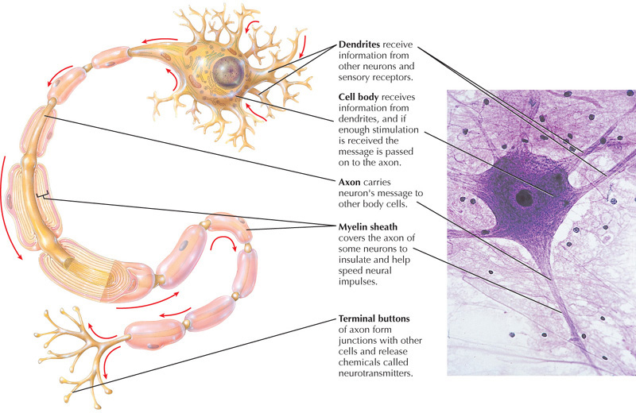
Let’s Review!

Slide 12
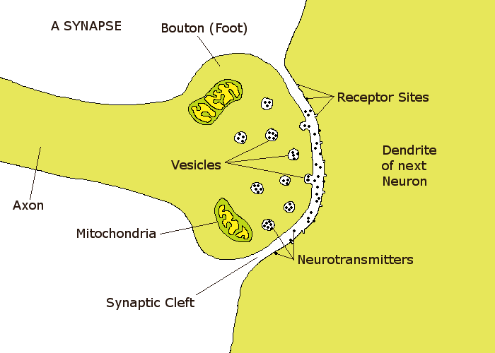
__________
Presynaptic Neuron
________
________
____________
________________________

Slide 13
Neurotransmitters
Neurotransmitters are chemical substances that reside in the axon terminals
They communicate to other neurons by binding to receptors on neighboring neurons

Slide 14
Chemical Communication
The communication between neurons is chemical
Neurotransmitter are either neutralized by an enzyme or taken back up by the neuron that released it in reuptake.
At least 50 different types of neurotransmitters have been identified

Slide 15
Chemical Communication

Slide 16
Synaptic Transmission
The neurotransmitters are released from the vesicles and then attach to receptors located on the postsynaptic neuron.
These neurotransmitters are in contact with the dendrite of the postsynaptic neuron only briefly.
The chemical is almost immediately destroyed.
Notes:
This whole process takes 2 miliseconds

Slide 17
Neurotransmitters
At least 50 different types of neurotransmitters have been identified
Acetylcholine
GABA
Serotonin
Dopamine
Norepinephrine
Endorphins

Slide 18
Neural network
It is used to refer a n/w or ckt of biological neurons.
Two types of Neural network
1. Biological Neural network
2. Artificial Neural network

Slide 19
. Biological Neural network
It is made up of real biological neurons that are connected functionally related in a nervous system.
Artificial Neural network
It is made up of interconnecting Artificial neurons.
It is used to gain or understanding Biological Neural network

Slide 20
Biological Neurons consist of 3 main parts:-
Soma or cell body
Dendrites
Axon

Slide 21
Soma or cell body
In soma large amount of information is located .
Dendrites
It is connecting links b/w neurons.
It looks like branch of tree.
All I/P from other neuron arrive through the dendrites.
Axon
It carries the impulse of a neuron to other neurons .

Slide 22
Basic properties of neurons
Signals are received by the processing element. This element sums the weighted input.
The weight at the receiving end has the capability to modify the incoming signal.
The neurons transmits the o/p where sufficient i/p is obtained.
The o/p produced from one neuron may be transmitted to other neurons.
The wt can be modify by experience.

Slide 23
Levels of Brain Organization
1. Molecules and Ions
2. Synapses
3. Neuronal microcircuits
4. Dendrites trees
5. Neurons
6. Local circuits
7. Inter-regional circuits
8. Central nervous system

Slide 24
Biological Neurons
1.The majority of neurons encode their activations or outputs as a series of brief
electrical pulses (i.e. spikes or action potentials).
2.The neuron’s cell body (soma) processes the incoming activations and converts
them into output activations.
3.The neuron’s nucleus contains the genetic material in the form of DNA. This
exists in most types of cells, not just neurons.
4.Dendrites are fibres which emanate from the cell body and provide the receptive

Slide 25
zones that receive activation from other neurons.
5. Axons are fibres acting as transmission lines that send activation to other neurons.
6. The junctions that allow signal transmission between the axons and dendrites are
called synapses.

Slide 26
Neural Signal Processing
The key components of neural signal processing are:
Signals from connected neurons are collected by the dendrites.
2. The cells body (soma) sums the incoming signals .
3. When sufficient input is received , the neuron generates an action potential or ‘spike’ .

Slide 27
4. That action potential is transmitted along the axon to other neurons.
5. If sufficient input is not received , the inputs
quickly decay and no action potential is generated.
6. Timing is clearly important – input signals must arrive together, strong inputs will
generate more action potentials per unit time

Slide 28
Artificial neuron
It is a mathematical function conceived as a model of biological neurons, known as neural network.
Artificial neurons are elementary units in an artificial neural network.
The artificial neuron receives one or more inputs and sums them to produce an output

Slide 29
Types of neurons
There are 3 types of neurons
Sensory neuron
Motor neuron
Inter neuron

Slide 30
Sensory neuron
It respond to touch, sound, light and effecting all the sensory organs that sends signal to the spinal cord and brain.
Motor neuron
It receive the signals from the brain and spinal cord , due to this neuron muscles contract and affects in glands takes place.

Slide 31
3. Inter neuron
It connects neurons to other neurons within the same region of the brain or spinal cord.

Slide 32
Fundamental Types of Neurons
Sensory (afferent) neurons
receptors detect changes in body and external environment
this information is transmitted into brain or spinal cord
Interneurons (association neurons)
lie between sensory & motor pathways in CNS
90% of our neurons are interneurons
process, store & retrieve information
Motor (efferent) neuron
send signals out to muscles & gland cells
organs that carry out responses called effectors
Notes:
What do you need to percieve? We’ll talk about that in more detail later, but pressure, light, vibrations, chemical flavors, you need docking bays to receive these and change transduce those types of energy into chemical energy.

Slide 33
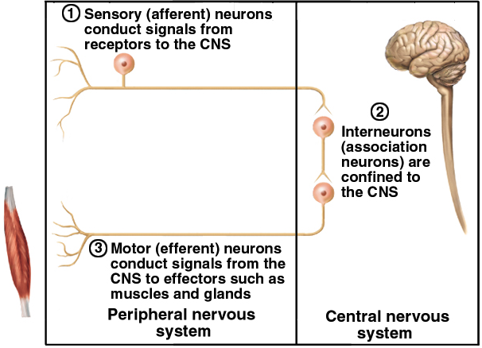
Fundamental Types of Neurons
Notes:
The trick that interneurons pull off is taking the information from thousands of inputs and being able to focus on a few of them, coordinate the important ones. Realize if you had to consciously think about walking; long ago you taught your brain the walking program and it will carry out the thousands of muscle, and joint movements smoothly non linearly, all at once so you can strut strut your stuff on the cat walk. If you had to think about it one move at a time; okay pull up right thigh, pull forward right calf, extend left calf, plant right heel, plant right toe, reverse. And while focusing on that what aren’t you thinking of? Diaphragm up, Diaphragm down, Heart pump blood in, Heart Pump blood out. How many times have I pumped my heart this minute? Digest Digest Digest. Focus Eyes. Girl! Girl! Control the nether regions Control the nether regions. System failure. Brain overload. Dump stomach contents. Which of course brings me to the properties of neurons

Slide 34
Fundamental Properties of Neurons
Excitability (irritability)
ability to respond to changes in the body and external environment called stimuli
Conductivity
produce traveling electrical signals
Secretion
when electrical signal reaches end of nerve fiber, a chemical neurotransmitter is secreted
Notes:
They can be triggered, set off, activated, booted up.
Electricity of course coming from the greek elektra which was the greek word for Amber which caused static electricity. Then in the 1700’s Ben Franklin figured out the flow of + and – particles which your cells do with ions
Do these so they can communicate which electricity and chemicals in an aqueous environment.

Slide 35
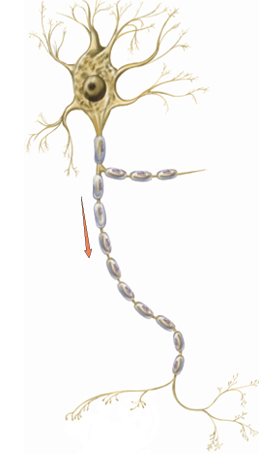
Structure of a Neuron
Cell body = soma
single, central nucleus with large nucleolus
cytoskeleton of microtubules & neurofibrils (bundles of actin filaments)
compartmentalizes RER into Nissl bodies
lipofuscin product of breakdown of worn-out organelles -- more with age
Vast number of short dendrites
for receiving signals
Singe axon (nerve fiber) arising from axon hillock for rapid conduction
axoplasm & axolemma & synaptic vesicles
Notes:
Dendr = Tree
Nissl bodies are unique to neurons and offer a useful way to identify them under the microscope
Lipofuscin are alos called wear and tear molecules, they are apparently harmless, the left overs of metabolism
Where would a neuron be receiving signals from? What will it have to do if its receiving multiple and varied signals? You go home, Mom: Clean room, Dad Do as Mother says, Friend: Big Party Ex Girlfriend who just dumped you: I’m going to party don’t come. What do you do hot shot what do you do? “ Dennis Hopper as Howard Payne in Speed 1994 rated R for violence and language
Also note the Schwann cells insulating the neuron, wrapping them in myelin sheaths, and the Nodes of Ranvier between the cells

